Slide 1
Lab 14 Java Monitor
TA: Yung-Hsu Chu
Professor: Hsung-Pin Chang
Operating System Lab

Slide 2
Outline
Introduction
Example & Exercise
Reference

Slide 3
Outline
Introduction
Example & Exercise
Reference

Slide 4
Why we need Monitor ?
Semaphores and mutex lock provide a convenient and effective mechanism for process synchronization.
Using them incorrectly can result in timing errors.
Caused by an uncooperative programmer.

Slide 5
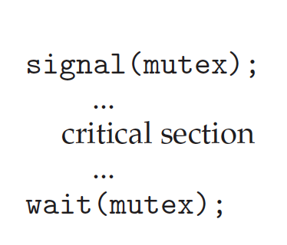
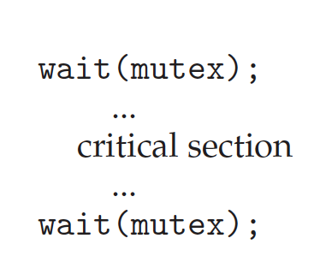

Why we need Monitor ? (cont.)
case 1
case 2
case 3
case 4

Slide 6
What is Monitor ?
Abstract data type for process synchronization.
Encapsulate private data with public method
Variables can be accessed by only the local procedures.
Only one process may be active within the monitor
at a time.
Consequently, the programmer doesn’t need to code
this synchronization constraint explicitly

Slide 7
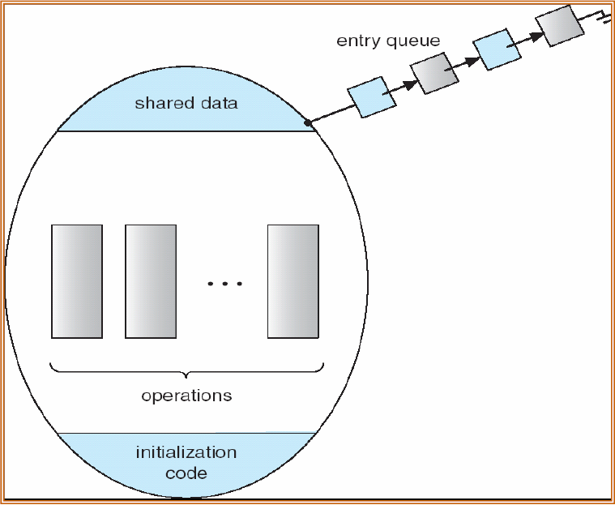
What is Monitor ? (cont.)
Store share variable
access
procedure

Slide 8

Condition variable
Tailor-made synchronization scheme can define one or more variables of type condition.
x.wait() | process invoking this operation is suspended until another process invokes
x.signal() | resumes exactly one suspended process

Slide 9
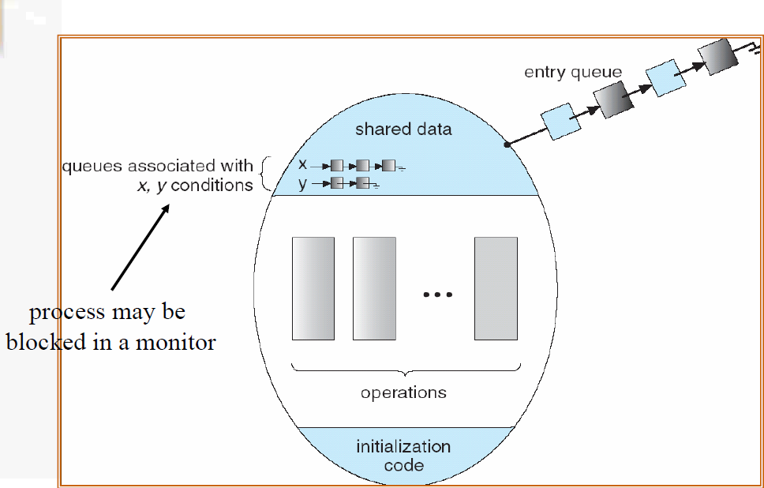
Condition variable (cont.)

Slide 10
Outline
Introduction
Example & Exercise
Reference

Slide 11
JAVA Monitor
There are two methods for monitor-like mechanisms in Java.
Synchronized
Reentrant Locks

Slide 12
Synchronized
Synchronized
public class Oslab{
private int Osgrade;
private int Osize;
public synchronized void XXX(){
}
public synchronized void YYY(){
}
public synchronized void ZZZ(){
}
}

Slide 13
Synchronized
Block synchronized
public void someMethod() {
/* non-critical section */
synchronized(this) {
/* critical section */
}
/* remainder section */
}

Slide 14
Example 1
A program declares a global variable count and then creates three identical threads.
Each thread increments the same global variable 25,000,000 times.
So count is incremented a total of 75,000,000 times.
The main program waits for the three threads to
complete.
Using the Synchronized to solve race condition problem.

Slide 15
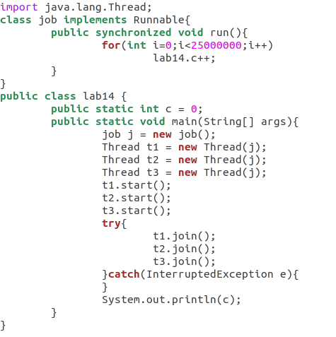
Example 1 (cont.)

Slide 16
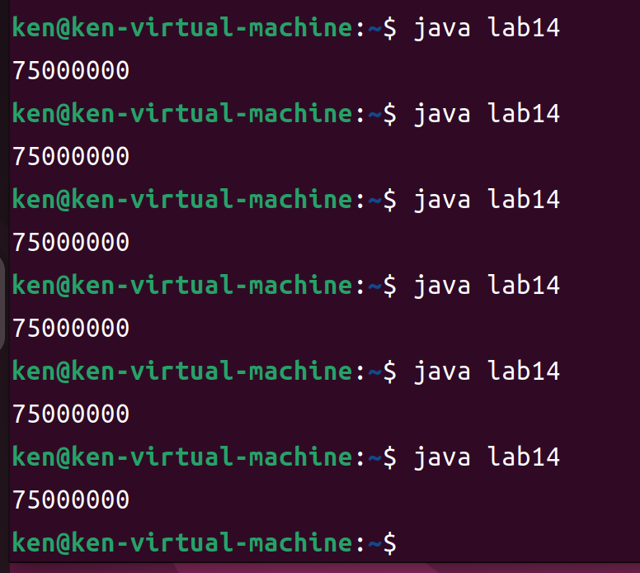
Example 1 (cont.)

Slide 17
Exercises 1
Using Java Language to do the same work shown in the final example of the Lab12 ( “Semaphores”) .[+35pt.]
2 threads do increase by one 25,000,000 times
2 threads do decrease by one 25,000,000 times
Using Synchronized to solve the race condition occurred.[+35pt.]

Slide 18
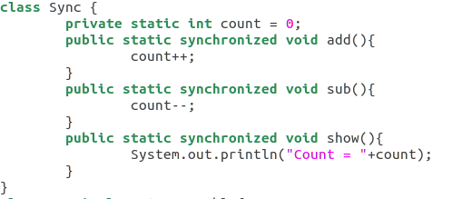
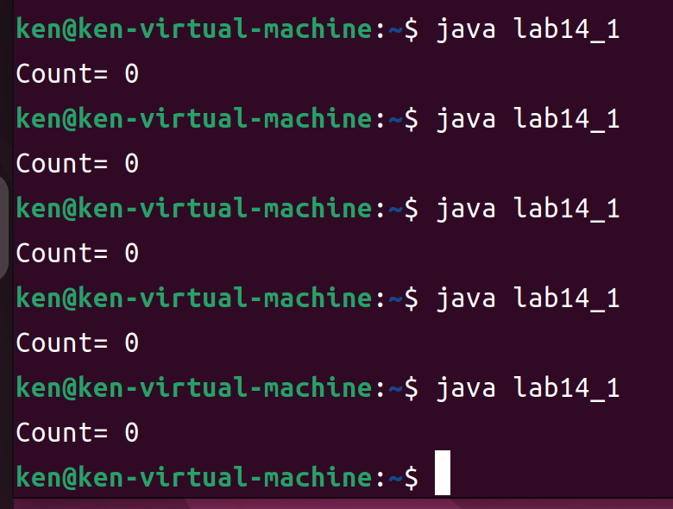
Exercises 1

Slide 19
JAVA Monitor
There are two methods for monitor-like mechanisms in Java.
Synchronized
Reentrant Locks

Slide 20
Reentrant Locks
ReentrantLock is owned by a single thread
provide mutually exclusive access to a shared resource
A thread acquires a ReentrantLock lock by invoking its lock() method
Available ( or already owns it ): enter critical section
Unavailable: blocks until owner unlock() lock

Slide 21
Reentrant Locks
Additional features :
Timeout while waiting for lock (lock interruptibly)
A fairness parameter
API to get list of waiting thread for lock
Flexibility to try for lock without blocking

Slide 22
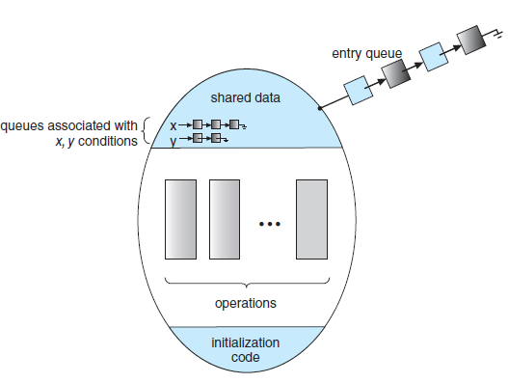
Reentrant Locks
import java.util.concurrent.locks.*;
public class Oslab{
Lock lock = new ReetrantLock();
Condition Full = lock.newCondition();
Condition Empty = lock.newCondition();
public void XXX(){
lock.lock();
try{
if(...){
Full. await();
}
if(...){
Empty.signal();
}
}
catch(InterruptedException e){
e.printStackTrace();
}
finally{
lock.unlock();
}
}
Condition Variables

Slide 23
Example 2
As an example, suppose we have a Warehouse which supports ”setProduct ” and “getProduct” methods.
If a ”getProduct” is attempted on an empty warehouse, then the thread will block until an item becomes available.
If a ”setProduct” is attempted on a full warehouse, then the thread will block until a space becomes available.
Using the ReetrantLock to solve race condition problem.

Slide 24
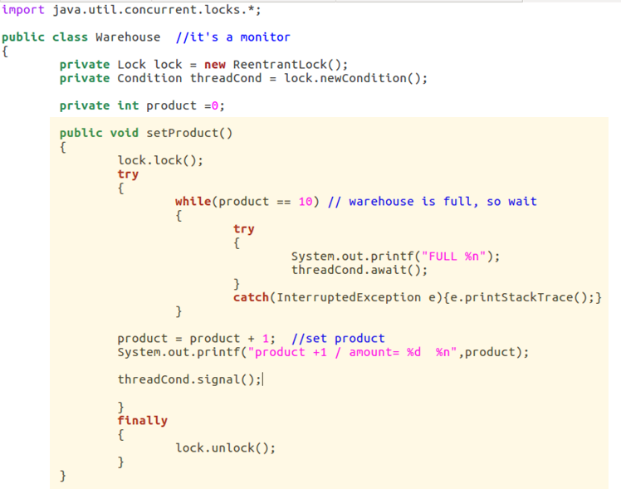
Example 2(cont.)

Slide 25
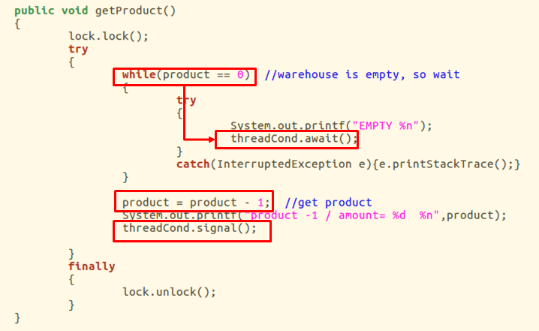
Example 2(cont.)

Slide 26
Exercises 2
Using the ReetrantLock to solve the multiple Producer-multiple Consumer Problem. [+30pt.]
Constraint:
The maximum amount of product is 10.
The minimum amount of product is 0.
If the total amount of product is zero and consumer want to consume, print “empty” on the screen.
If the total amount of product is ten and producer want to produce, print “full” on the screen.
Print every transaction.

Slide 27
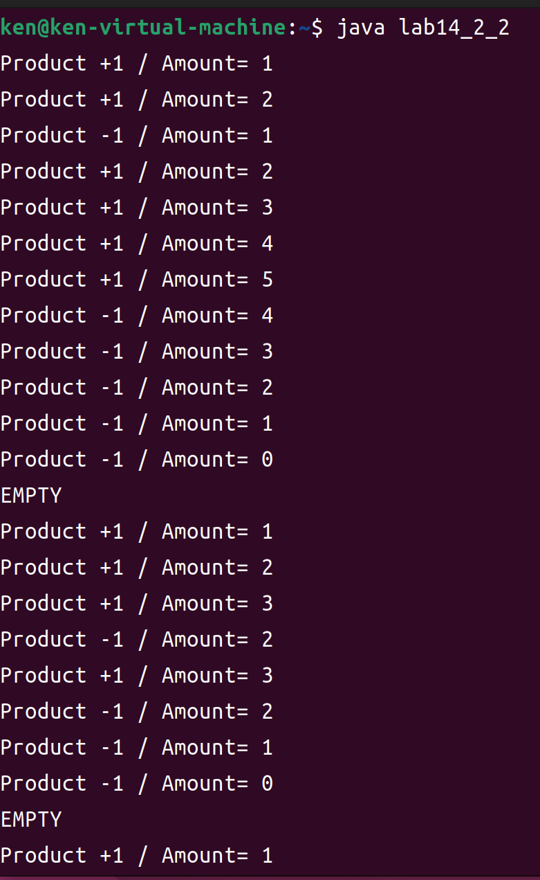
Exercises 2(cont.)

Slide 28
References
Textbook
Operating System Concepts, 10th Edition (Chapter 7.4)
Website
Synchronized：
https://www.baeldung.com/java-synchronized
ReentrantLock：
https://www.geeksforgeeks.org/reentrant-lock-java/
https://dzone.com/articles/what-are-reentrant-locks
Interface Condition：
http://java.sun.com/j2se/1.5.0/docs/api/java/util/concurrent/locks/Condition.html

